Slide 1
Preconnect, prefetch, prerender ...
aka, building a web performance oracle in your application!
Ilya Grigorik - @igrigorik
igrigorik@google.com

Slide 2
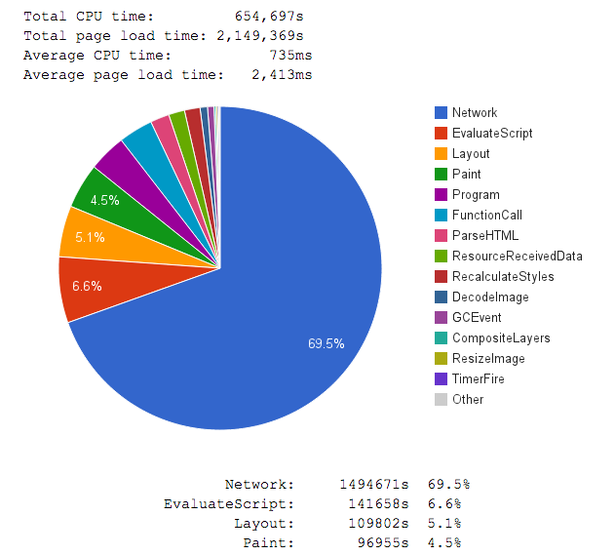
Top 1M Alexa sites...
Cable profile (5Mbps / 28 ms RTT)
Main thread attribution in Blink
Measured via Telemetry
69.5% of time blocked on network
6.6% of time blocked JavaScript
5.1% blocked on Layout
4.5% blocked on Paint
...
No surprise here (hopefully)
First page load is network bound
First page load is latency bound
blink-dev thread
@igrigorik

Slide 3
Our pages consist of dozens of assets
… (snip 30 requests) ...
52 requests
4+ seconds
Huh?
Primer on Web Performance (Chapter 10)
@igrigorik

Slide 4
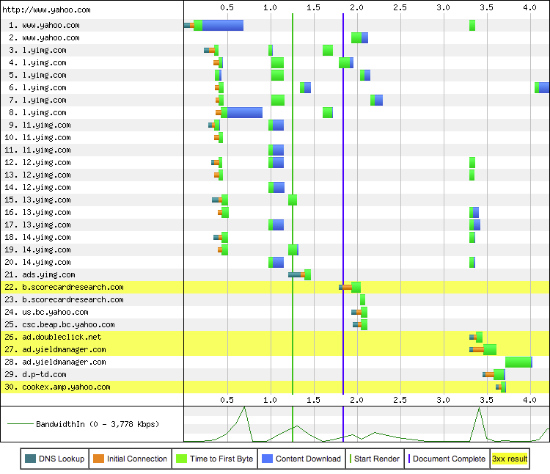
“Connection view” tells the story...
30 connections
DNS lookups
TCP handshakes
…
Blue: download time
We’re not BW limited, we’re literally idling, waiting on the network to deliver resources.
Speed, performance and human perception
@igrigorik

Slide 5
Let’s build a smarter browser!
We can hide some of the network latency through clever tricks.

Slide 6
The pre-* party...
Preresolve
Prefetch
Prerender
Preconnect
Primer on Web Performance (Chapter 10)
@igrigorik

Slide 7
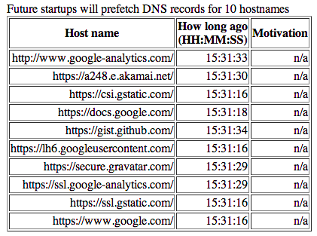
Pre-resolve DNS names on browser startup...
Scenario: when you load the browser first thing in the morning (or after restart), where do you usually head?
Let’s pre-resolve all of the popular names!
Chrome resolves top 10 destinations.
Head to chrome://dns/ to see your list.
High Performance Networking in Google Chrome
@igrigorik

Slide 8
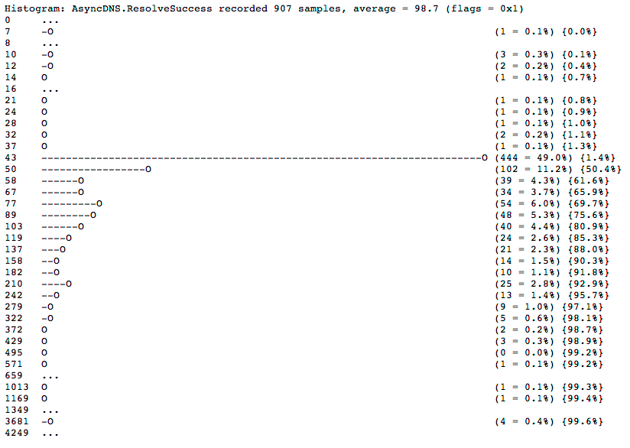
Preresolve is cute, but does it help much?
How fast is your local DNS? Chrome knows the answer...
chrome://histograms/DNS
Good case: < 30 ms
Average: 30-100 ms
Ouch: 100 ms+
High Performance Networking in Google Chrome
@igrigorik

Slide 9
Let’s predict where you’re heading next...
If you type in “ama” what’s the likelihood you’re heading to Amazon?
Chrome tracks the hit / miss count, and uses it to initiate DNS preresolve and TCP preconnect!
High confidence hits may trigger a full prerender in a background tab.
Head to chrome://predictors/ to see your list.
High Performance Networking in Google Chrome
@igrigorik

Slide 10
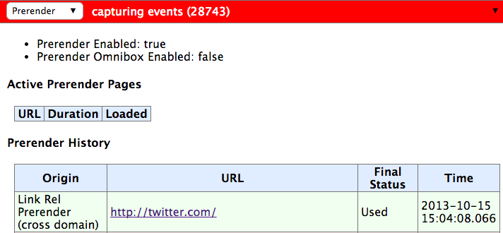
Hmm, pre-rendering you say? Tell me more...
Head to chrome://net-internals/#prerender
Try it yourself via prerender-test.appspot.com.
High Performance Networking in Google Chrome
@igrigorik

Slide 11
Instant Pages *is* Chrome Prerendering!
High Performance Networking in Google Chrome
@igrigorik

Slide 12
Could we optimize repeat visits further? Why, yes!
Remember subresource hostnames + track stats on pre{connect, resolve} rates
Use above information on future navigations to initiate appropriate actions...
Check your own site: chrome://dns
High Performance Networking in Google Chrome
@igrigorik

Slide 13
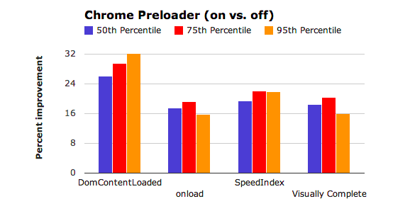
Can we discover critical resources quicker? Yep...
Chrome’s preloader delivers a ~20% speed improvement!
Blocking resources block DOM construction...
Preload scanner “looks ahead” in the HTML document to identify critical resources
JavaScript, CSS, etc.
Don’t hide your resources from the preload scanner! E.g. JS loaders, polyfills, etc.
Chrome preloader
@igrigorik

Slide 14
“We were using XHR to download CSS... When it came it our attention that XHRs are requested at low priority we decided to run an experiment to see its impact on G+ latency (vs using declarative markup like <link>).
In SPDY capable browsers it (using <link>) resulted in a big latency improvement. In Chrome 27 we saw a 4x speedup at the median, and 5x at 25th percentile. In Firefox 21 we saw a 5x speedup at median, and 8x at 25th percentile.”
Shubhie Panicker - G+ Front-end Team

Slide 15
In short, Chrome does a lot!
but you can help it…

Slide 16
The browser is trying to predict and anticipate user activity, but you have the app-specific insights - leverage them!
Pre-resolve DNS hostnames
Mark critical subresources (don’t hide them!)
Prefetch critical resources
Prerender where applicable
Speed is a feature (Chapter 1)
@igrigorik

Slide 17
Embed “dns-prefetch” hints...
<link rel="dns-prefetch" href="hostname_to_resolve.com">
<link rel="dns-prefetch" href="host2.com">
Embed prefetch hints in <head> to hint the browser to pre-resolve these names.
Useful for critical resources later in the page
Useful for resources behind a redirect
host1.com/resource > 301 > host2.com/resouce
dns-prefetch: host2.com
(or even better, eliminate the redirect :))
High Performance Networking in Google Chrome
@igrigorik

Slide 18
Embed “subresource” hints...
<link rel="subresource" href="critical/app.js">
<link rel="subresource" href="critical/style.css">
Embed subresource hints in <head> to initiate immediate fetch for current page!
Subresource hint identifies critical resources required for current page load.
Place subresource hints as early as possible.
In a way, this is a “manual preload scanner” strategy ...
High Performance Networking in Google Chrome
@igrigorik

Slide 19
Embed “prefetch” hints...
<link rel="prefetch" href="checkout.html">
<link rel="prefetch" href="other-styles.css">
Embed prefetch hints in <head> to initiate deferred fetch for later navigation.
Prefetch hint identifies resources that may be needed in future navigation.
Prefetch hints have lowest possible priority.
Prefetch hints are content agnostic: fetch asset, place in cache.
You do have cache headers enabled, right? Right?
High Performance Networking in Google Chrome
@igrigorik

Slide 20
Embed “prerender” hints...
<link rel="prerender" href="checkout.html">
Embed prerender hints in <head> to initiate background prerender of entire page!
The page is fetch, and all of its assets!
Use Page Visibility API to defer JS actions until page is visible.
Analytics beacons (GA does this already), custom code, etc.
Only “safe” pages can be prerendered (aka, GET).
Prerendering is resource heavy - use with caution.
High Performance Networking in Google Chrome
@igrigorik

Slide 21
Predict, measure, optimize… iterate.
You can inject each of the hints when the page is generated
You know the structure of the page / application, use it...
Run offline log analysis (e.g. step_a.html > step_b.html)
You can inject hints “at runtime” based on user interactions!
Via the magic of JavaScript, simply add the appropriate link tag:
var hint = document.createElement("link")
hint.setAttribute("rel", "prerender")
hint.setAttribute("href", "next-page.html")
document.getElementsByTagName("head")[0].appendChild(hint)
P.S. If the hint is no longer relevant, reverse works also.. nuke it from the DOM!

Slide 22
TL;DR
<link rel="dns-prefetch" href="hostname_to_resolve.com">
Pre-resolve DNS hostnames for assets later in the page! (Most browsers)
<link rel="subresource" href="/javascript/myapp.js">
Initiate early resource fetch for current navigation (Chrome only)
<link rel="prefetch" href="/images/big.jpeg">
Prefetch asset for a future navigation, place in cache… (Most browsers)
<link rel="prerender" href="//example.org/next_page.html">
Prerender page in background tab for future navigation
Twitter igrigorik
Email igrigorik@google.com
Web igvita.com
Slides @ bit.ly/1bUFCsI
Checkout Steve’s prebrowsing slides!

